Slide 1
Prediction Model Report
Home Equity Line of Credit (HELOC)
Congrong Shen
Yuying He
Sichun Li
Tianyao Liu
Yingluo You

Slide 2
Table of
Contents
Data Cleaning
Model
Construction
Hyper- parameter
Tuning
Model
Evaluation
01
02
03
04
04
Interface

Slide 3
01
Data Cleaning

Slide 4
01
Data Cleaning
Imputer: Fill Missing Values
1 in ‘MaxDelqEver’
Special Values
Dealing with Categorical Variables - Output
Transform ‘RiskPerformance’ to ‘0’ and ‘1’
Dealing with Categorical Variables - Input
‘MaxDelq2PublicRecLast12M’ and ‘MaxDelqEver’
‘6’ -> ‘5’; ‘9’ -> ‘8’
Feature Scaler
Standard Scaler

Slide 5
Model
Construction
02

Slide 6
02
Model Construction
Create Train Set and Test Set
train_test_split
test set size=0.2
Model Construction Framework
Pipeline :data cleaning /transformation rules
Set hyperparameters
GridSearchCV :construct models
cv=5 → cross validation
Used Models
Logistic Regression
Decision Tree
Random Forest
Gradient Boosting
Linear Discriminant Analysis
K—Nearest Neighbors

Slide 7
Hyper-parameter
Tuning
03

Slide 8
03
Parameter Tuning
Gradient Boosting Classifier
Logistic regression
Random Forest
KNN
Use n_estimators, max_features and max_depth to design “tree”
learning_rate and n_estimaters determine the fitting effect
Set hyper parameter from 1-5 to decrease approximate error
Limited linspace value ranges
Used grid search to find the optimal combination of hyperparameter values with clear results

Slide 9
Model
Evaluation
04

Slide 10

04
Evaluation Metrics
Accuracy = Number of correct predictions / Total number of predictions
Accuracy
Recall
Precision
Recall = TP / (TP + FN)
Precision = TP / (TP + FP)
Metrics
Harmonic mean of the accuracy and recall rate.
The range of the F1 score is [0,1].
F1 Score
AUC
AUC is defined as the area under the ROC curve, range is [0.5,1].

Slide 11
04
Model Performance
 | Accuracy | Recall | Precision | F1 Score
Logistic Regression | 0.711100 | 0.707082 | 0.689331 | 0.698093
Random Forest | 0.721237 | 0.699571 | 0.707158 | 0.703344
Gradient Boosting Classifier | 0.720730 | 0.712446 | 0.701162 | 0.706759
LDA | 0.719716 | 0.713519 | 0.699264 | 0.706320
Decision Tree | 0.7170385
KNN | 0.67659736

Slide 12
05
Interface

Slide 13
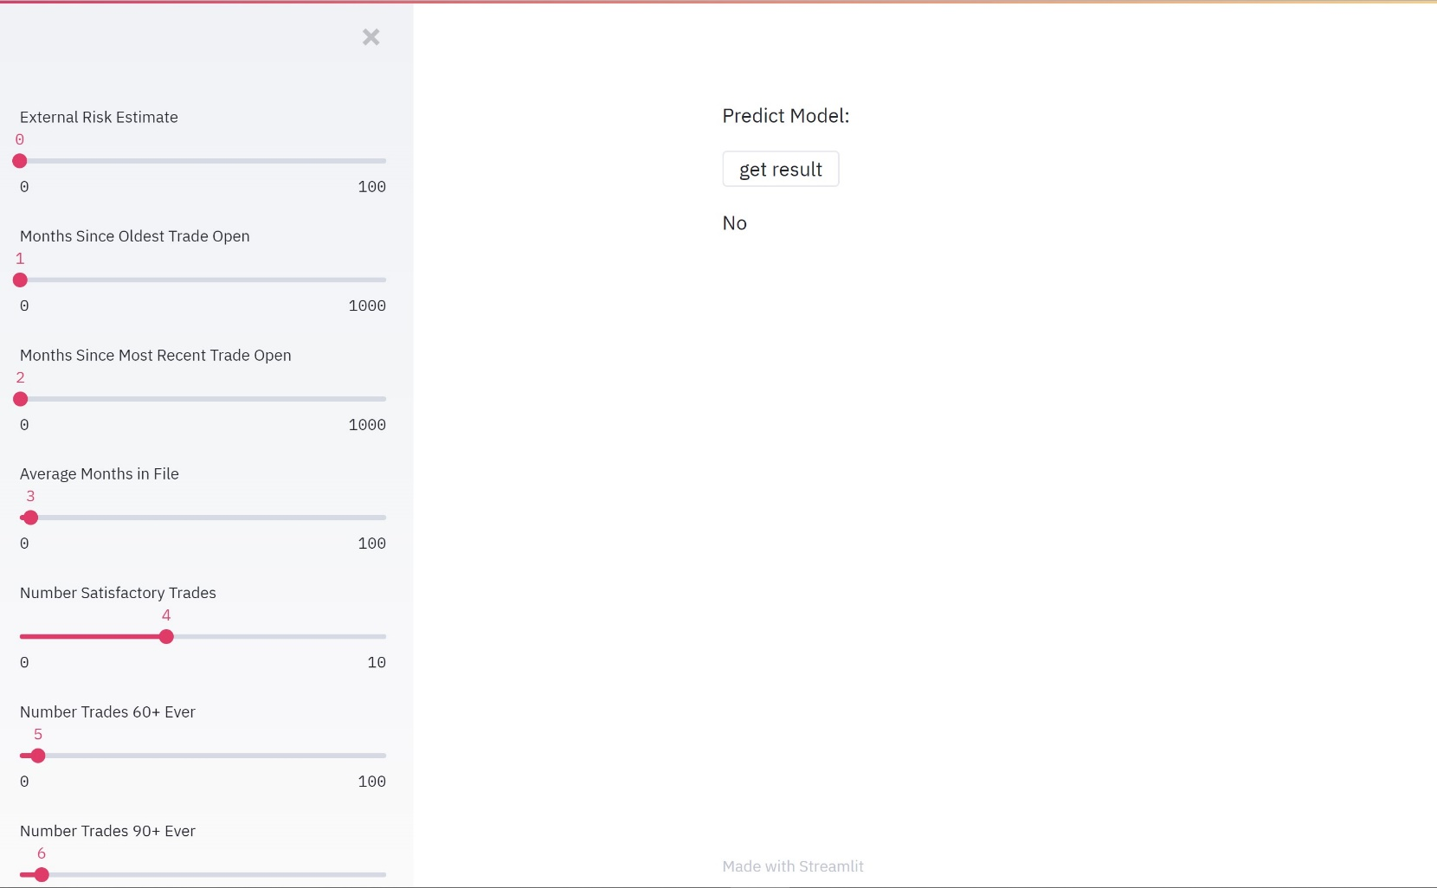
05
User Interface
When click “get result button, show predict result based on input
Sidebar for users to input variables

Slide 14
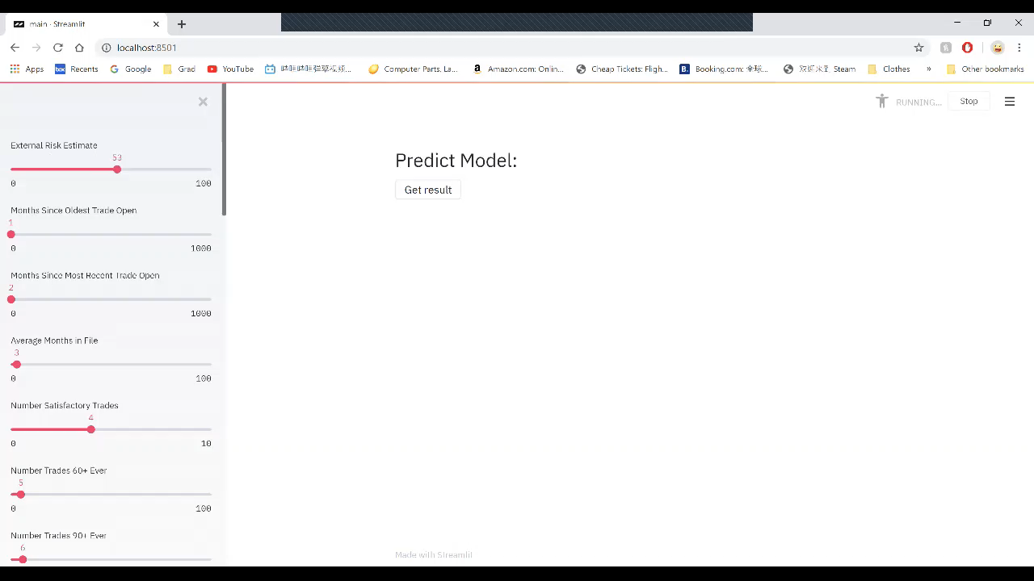
Demo

Slide 15
Q & A
THANK YOU FOR LISTENING

